Slide 1
CS419 Recitation Class
Webex: https://rutgers.webex.com/meet/sy558
every Monday's 7:00-8:00 pm
Notes:
/krɪpˈtɑːɡrəfi/

Slide 2
CS419 Recitation Class
Topic：Software Vulnerabilities
Notes:
/krɪpˈtɑːɡrəfi/

Slide 3
Why Software Vulnerabilities Matter?
• When a process reads input from attacker, the process may be exploited if it contains vulnerabilities.
• When an attacker successfully exploits a vulnerability, he can
• Crash programs: Compromises availability
• Execute arbitrary code: Compromises integrity
• Obtain sensitive information: Compromises confidentiality
• Software vulnerability enables the attacker to run with privileges of other users, violating desired access control policy
Notes:
/,stegə'nɔgrəfi/

Slide 4
Common Software Vulnerabilities
• Input validation
• Race conditions
• Time-of-check-to-time-of-use (TOCTTOU)
• Buffer overflows
• Format string problems
• Integer overflows
Notes:
/,stegə'nɔgrəfi/

Slide 5
Input Validation Vulnerabilities
Sources of Input that Need Validation:
• What are sources of input for local applications?
• Command line arguments
• Environment variables
• Configuration files, other files
• Inter-Process Communication call arguments
• Network packets
• What are sources of input for web applications?
• Web form input
• Scripting languages with string input
Notes:
/,stegə'nɔgrəfi/

Slide 6
Input Validation Vulnerabilities
Command line as a Source of Input: A Simple example
void main(int argc, char ** argv) {
char buf[1024];
sprintf(buf,”cat %s”,argv[1]);
system (“buf”);
}
What can go wrong?
• Can easily add things to the command by adding ;, using e.g., “a; ls”
• User can set command line arguments to almost anything, e.g., by using execve system call to start a program, the invoker has complete control over all command line arguments.
Sources of Input that Need Validation:
• What are sources of input for local applications?
• Command line arguments
• Environment variables
• Configuration files, other files
• Inter-Process Communication call arguments
• Network packets
Notes:
/,stegə'nɔgrəfi/

Slide 7
Input Validation Vulnerabilities
Environment variables
• Users can set the environment variables to anything
• Using execve
• Has some interesting consequences
• Examples:
• PATH
• LD_LIBRARY_PATH
• IFS
Sources of Input that Need Validation:
• What are sources of input for local applications?
• Command line arguments
• Environment variables
• Configuration files, other files
• Inter-Process Communication call arguments
• Network packets
Notes:
/,stegə'nɔgrəfi/

Slide 8
Input Validation Vulnerabilities
Sources of Input that Need Validation:
• What are sources of input for local applications?
• Command line arguments
• Environment variables
• Configuration files, other files
• Inter-Process Communication call arguments
• Network packets
Attack by Resetting PATH
• A setuid program has a system call: system(ls);
• The user sets his PATH to be . (current directory) and places a program ls in this directory
• The user can then execute arbitrary code as the setuid program
• Solution: Reset the PATH variable to be a standard form (i.e., “/bin:/usr/bin”)
Attack by Resetting IFS
• However, you must also reset the IFS variable
• IFS is the characters that the system considers as white space
• If not, the user may add “s” to the IFS
• system(ls) becomes system(l)
• Place a function l in the directory
• Moral: things are intricately related and inputs can have unexpected consequences
Attack by Resetting LD_LIBRARY_PATH
• Assume you have a setuid program that loads dynamic libraries
• UNIX searches the environment variable LD_LIBRARY_PATH for libraries
• A user can set LD_LIBRARY_PATH to /tmp/attack and places his own copy of the libraries here
• Most modern C runtime libraries have fixed this by not using the LD_LIBRARY_PATH variable when the EUID is not the same as the RUID or the EGID is not the same as the RGID
Notes:
/,stegə'nɔgrəfi/

Slide 9
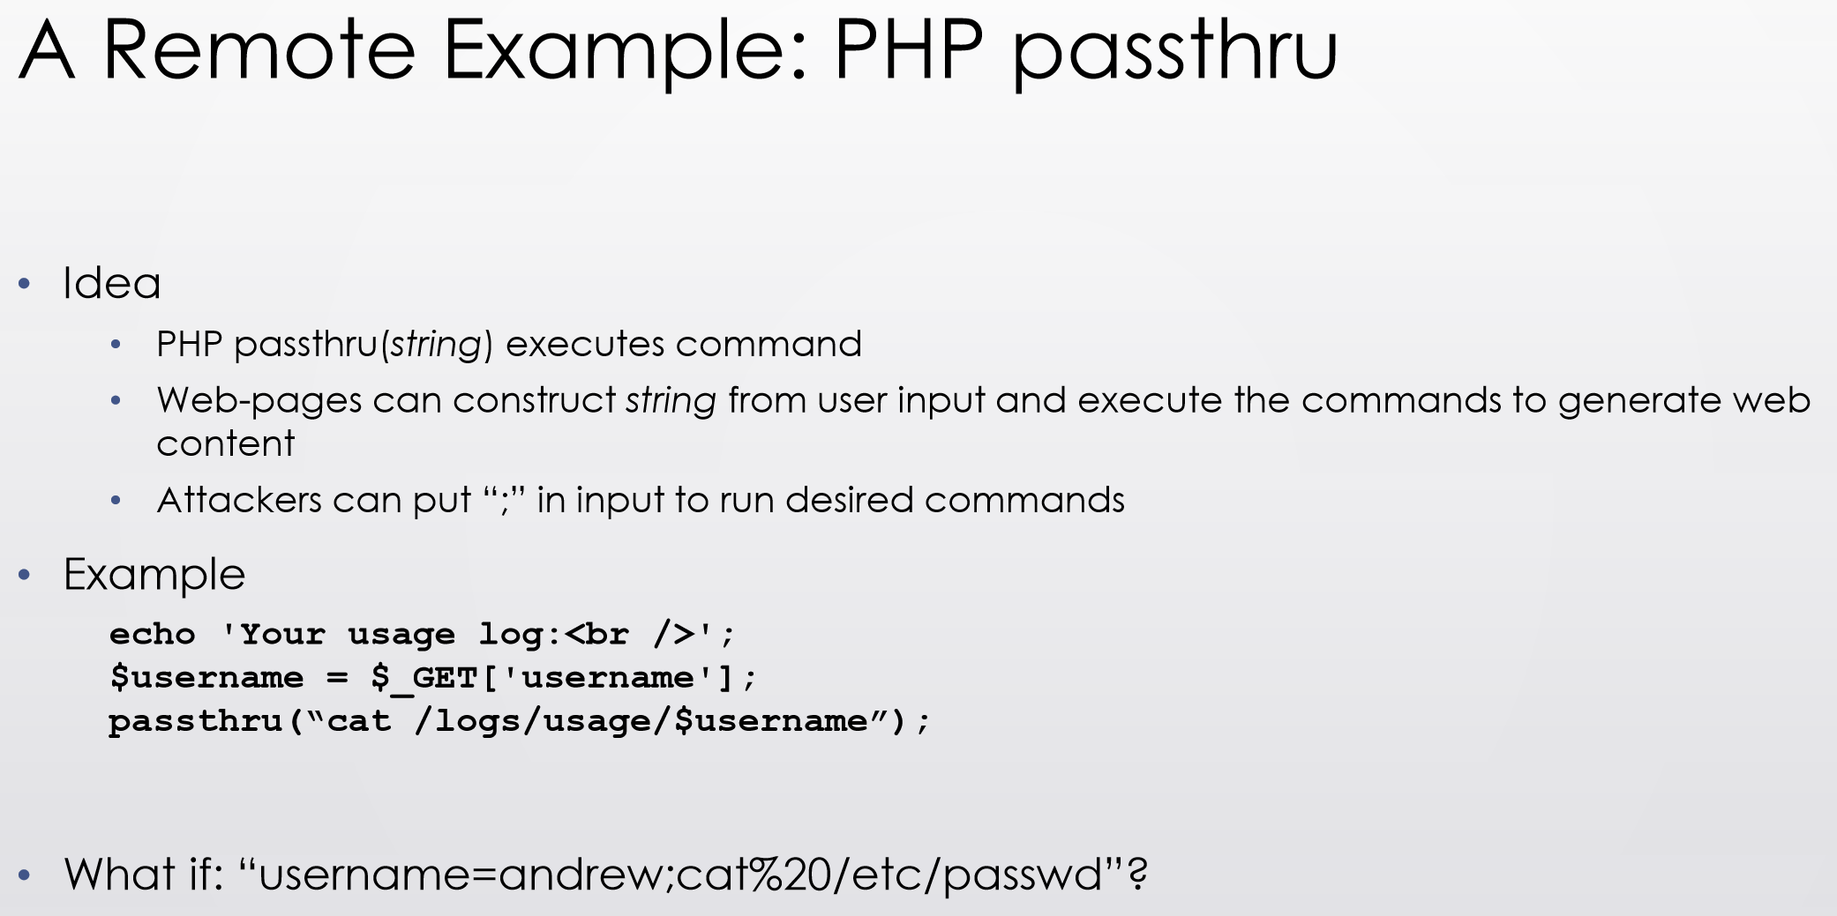
Input Validation Vulnerabilities
• SQL injection
• Caused by failure to validate/process inputs from web forms before using them to create SQL queries
• Cross Site Scripting
• Caused by failure to validate/process inputs from web forms or URL before using them to create the web page
• Cross Site Request Forgery is not an input validation issue
Sources of Input that Need Validation:
• What are sources of input for local applications?
• Command line arguments
• Environment variables
• Configuration files, other files
• Inter-Process Communication call arguments
• Network packets
• What are sources of input for web applications?
• Web form input
• Scripting languages with string input
Notes:
/,stegə'nɔgrəfi/

Slide 10
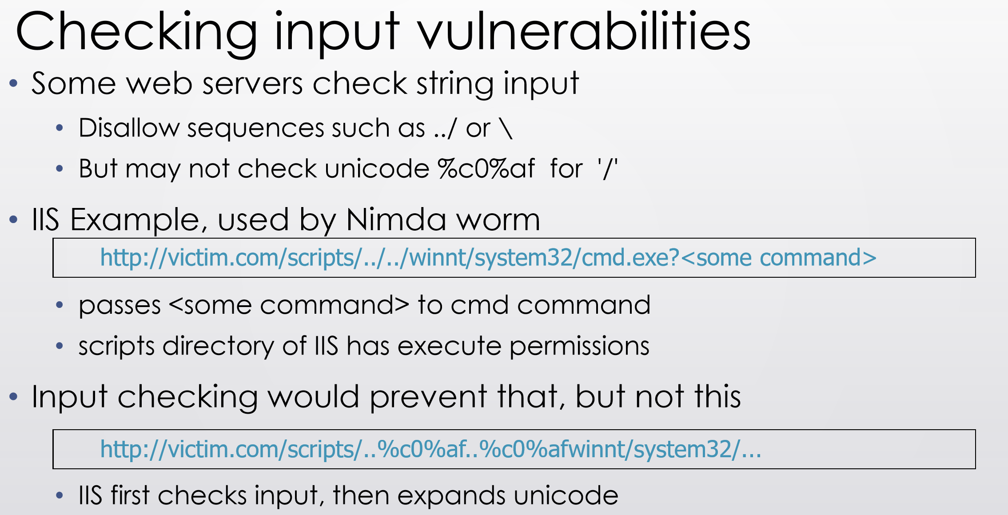
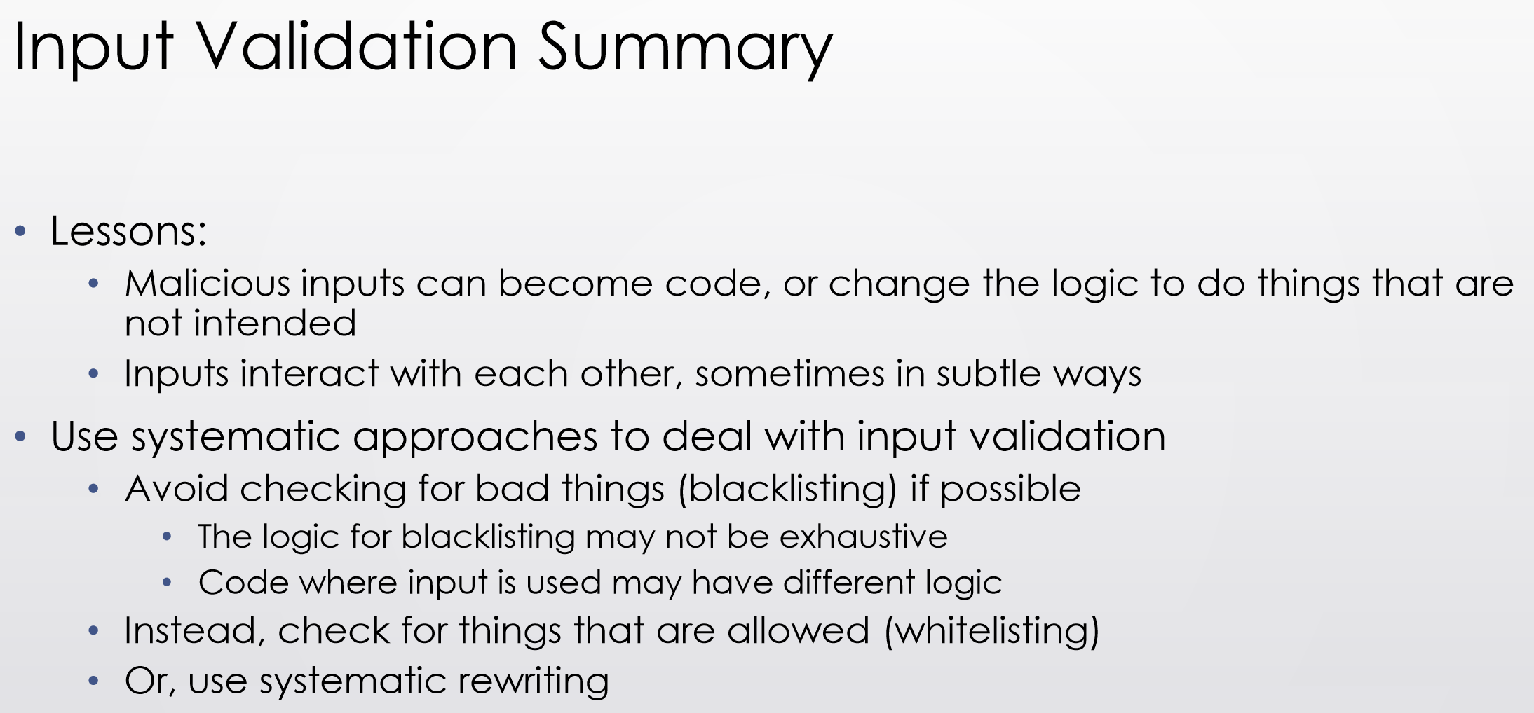
Input Validation Vulnerabilities
Notes:
/,stegə'nɔgrəfi/

Slide 11
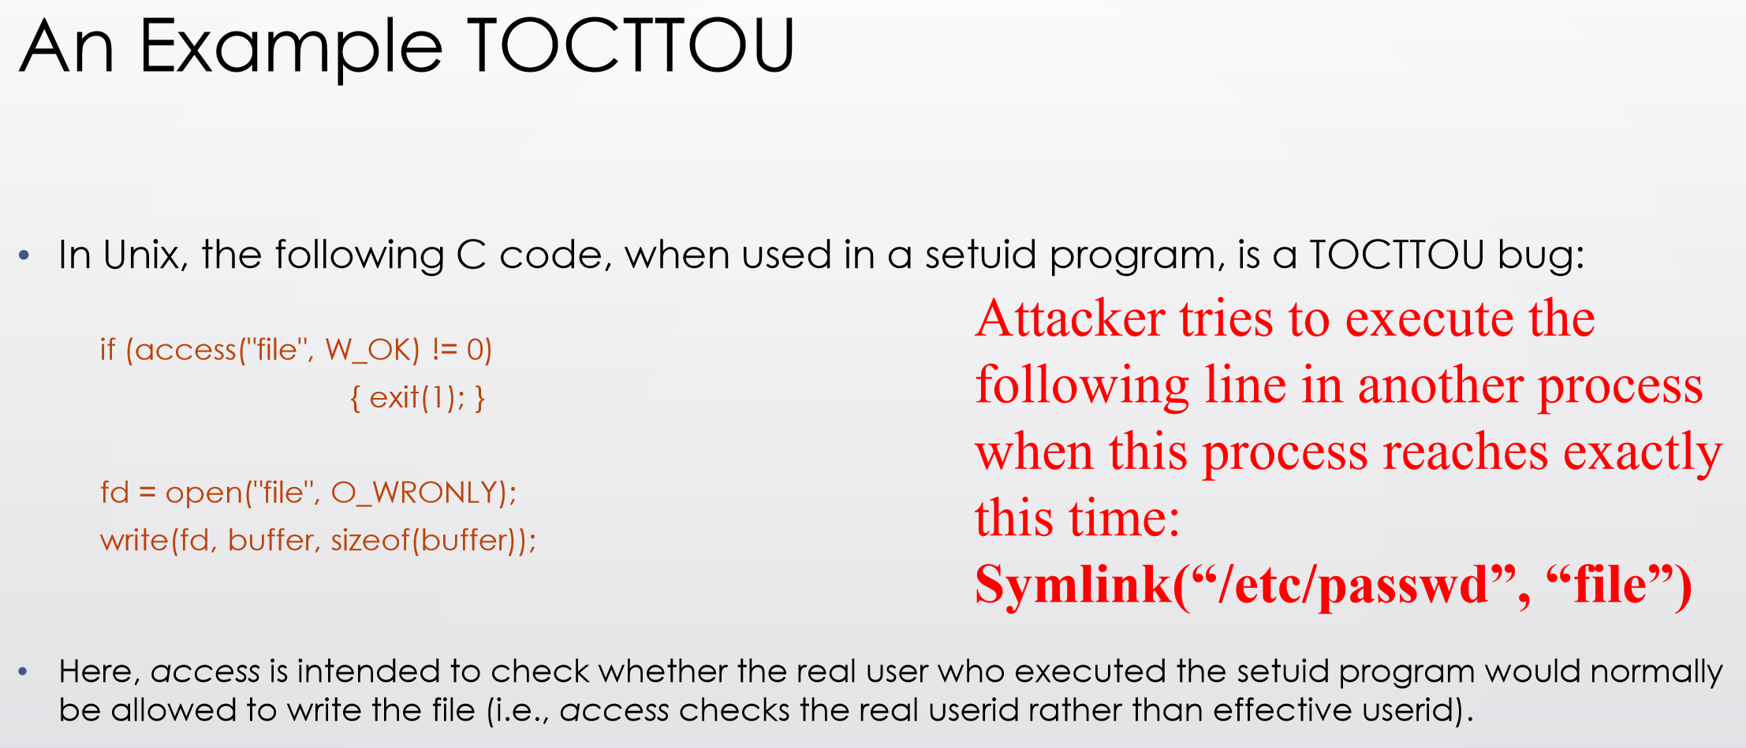
Time-of-check-to-time-of-use (TOCTTOU)
• TOCTTOU, pronounced “TOCK too”
• A class of software bug caused by changes in a system between the checking of a condition (such as authorization) and use of the results of the check.
• When a process P requests to access resource X, the system checks whether P has right to access X; the usage of X happens later
• When the usage occurs, perhaps P should not have access to X anymore.
• The change may be because P changes or X changes.
• Exploiting a TOCTTOU vulnerabilities requires precise timing of the victim process.
• Can run the attack multiple times, hoping to get lucky
• Most general attack may require “single-stepping” the victim, i.e., can schedule the attacker process after each operation in the victim
• Techniques exist to “single-step” victim
• Preventing TOCTTOU attacks is difficult
// After the access check
symlink("/etc/passwd", "file");
// Before the open, "file" points to the password database
In this example, an attacker can exploit the race condition between the access and open to trick the setuid victim into overwriting an entry in the system password database.
Notes:
/,stegə'nɔgrəfi/

Slide 12
Buffer overflows
What is Buffer Overflow?
• A buffer overflow, or buffer overrun, is an anomalous condition where a process attempts to store data beyond the boundaries of a fixed-length buffer.
• The result is that the extra data overwrites adjacent memory locations. The overwritten data may include other buffers, variables and program flow data, and may result in erratic program behavior, a memory access exception, program termination (a crash), incorrect results or ― especially if deliberately caused by a malicious user ― a possible breach of system security.
Types of Buffer Overflow Attacks
• Stack overflow
• Shell code
• Return-to-libc
• Overflow sets ret-addr to address of libc function
• Off-by-one
• Overflow function pointers & longjmp buffers
• Heap overflow
Notes:
/,stegə'nɔgrəfi/

Slide 13
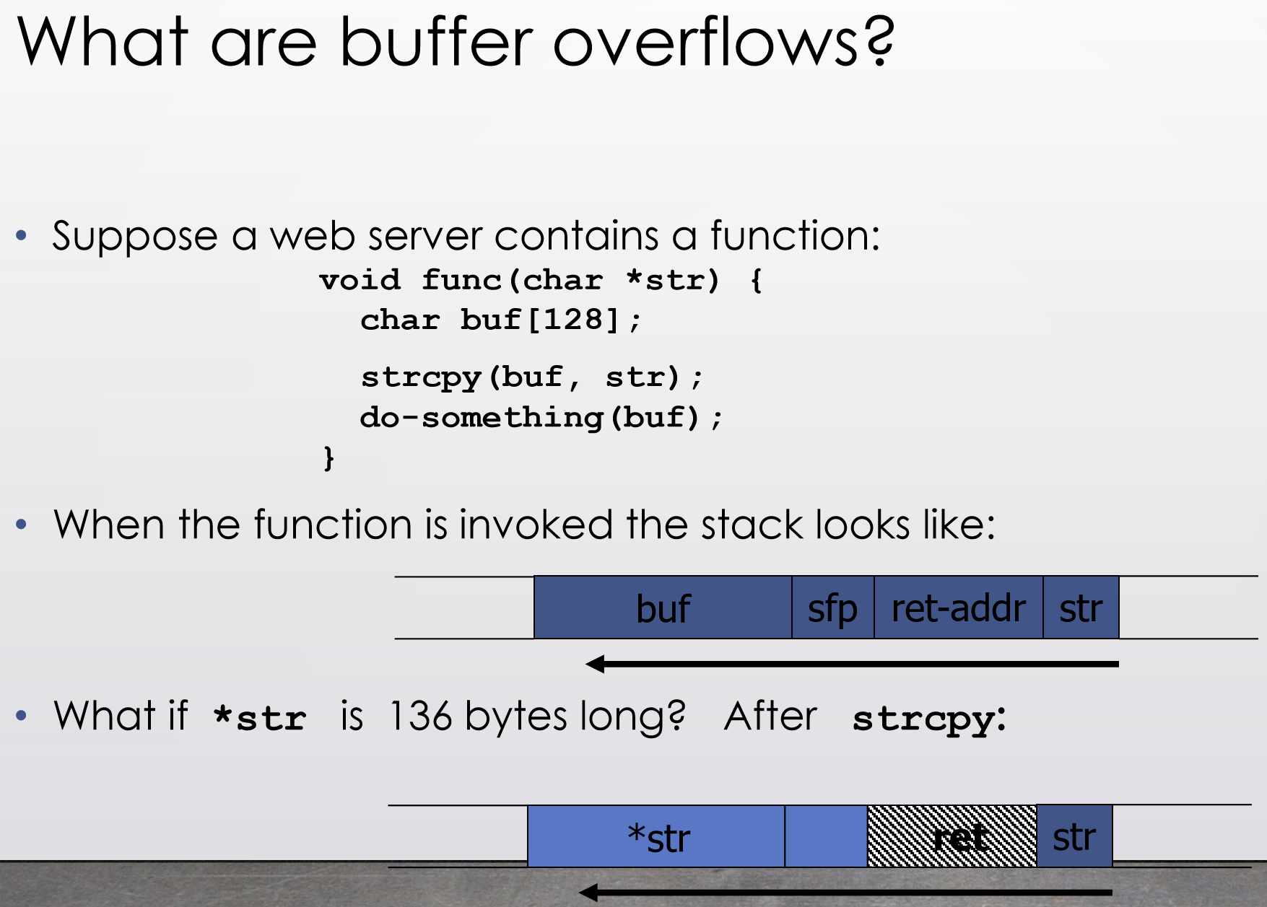
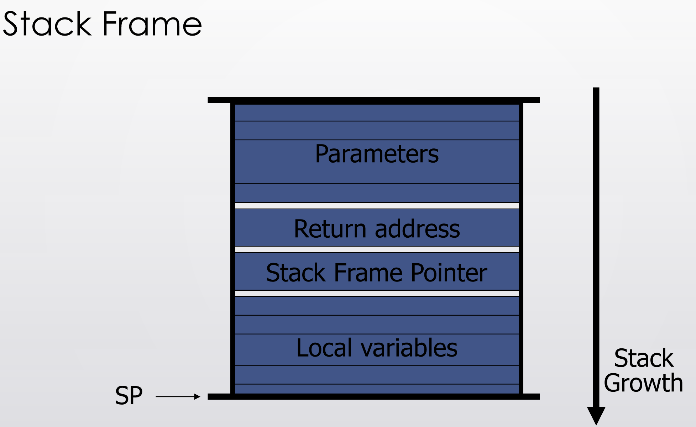
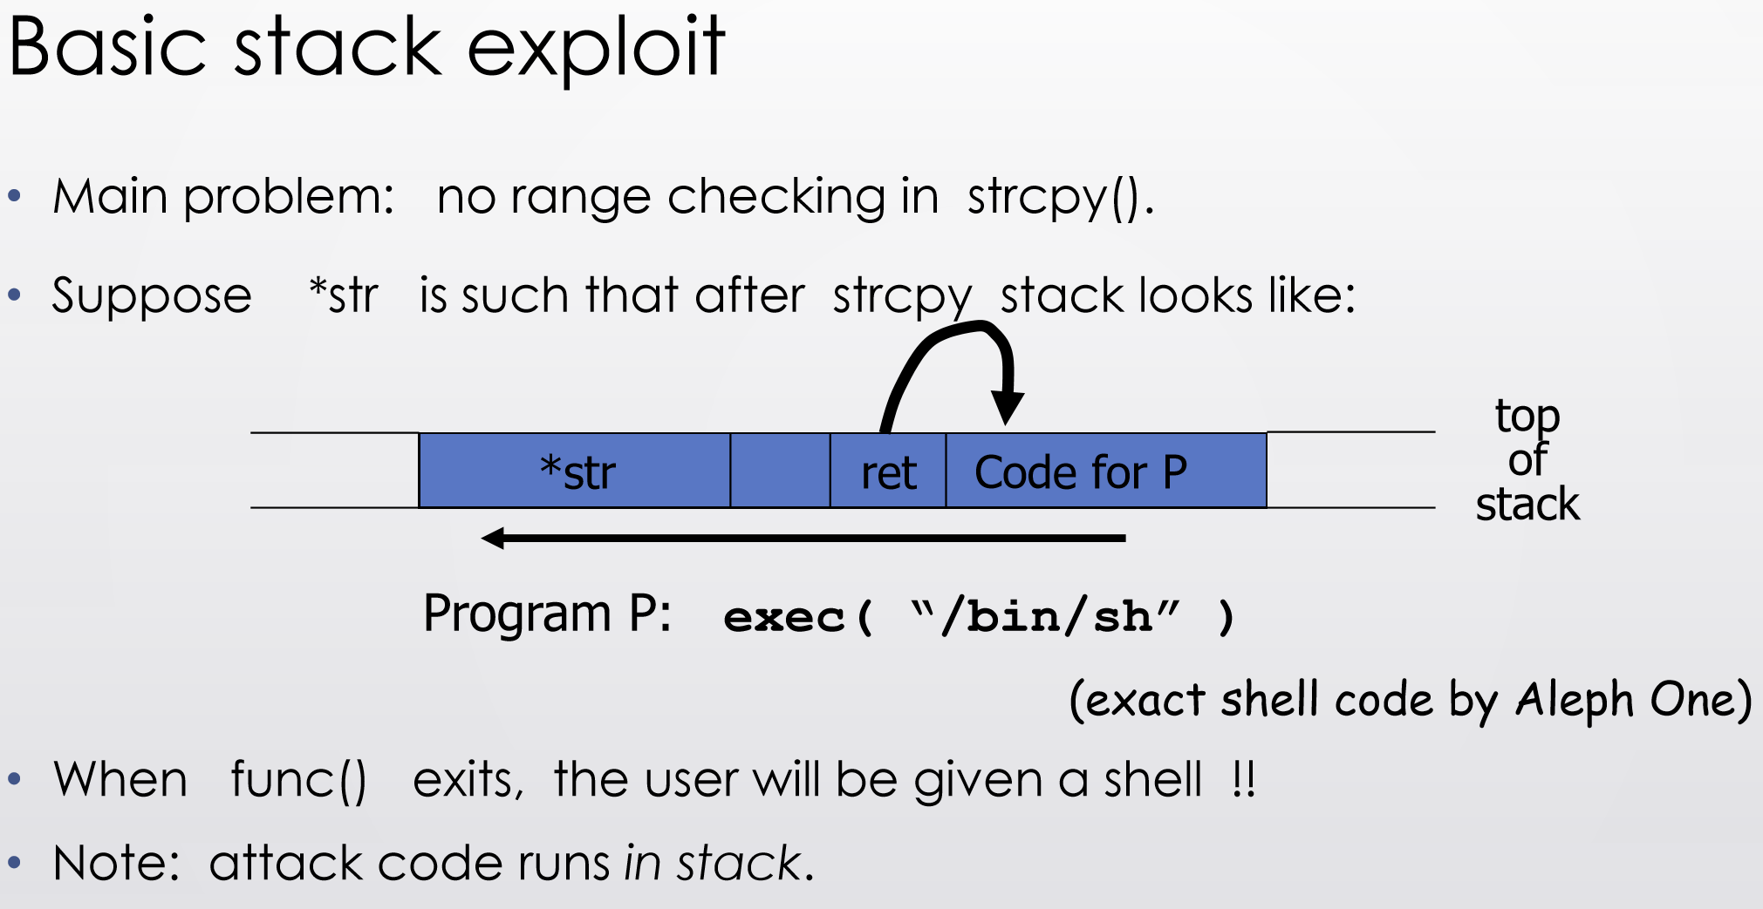
Buffer overflows
non-executable-stack
Carrying out this attack requires
• Determine the location of injected code position on stack when func() is called.
• So as to change RET on stack to point to it
• Location of injected code is fixed relative to the location of the stack frame
• Program P should not contain the ‘\0’ character.
• Easy to achieve
• Overflow should not crash program before func() exits.
• Some unsafe C lib functions:
• strcpy (char *dest, const char *src)
• strcat (char *dest, const char *src)
• gets (char *s)
• scanf ( const char *format, … )
• sprintf (conts char *format, … )
Notes:
/,stegə'nɔgrəfi/

Slide 14
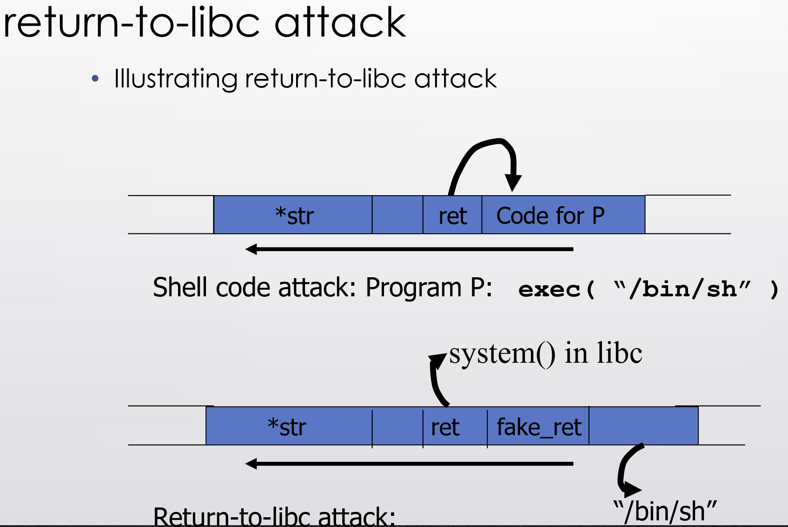
Buffer overflows — return-to-libc attack
return-to-libc attack
• “Bypassing non-executable-stack during exploitation using return-to-libs”
• Overflow ret address to point to injected shell code requires execution of injected code
• Many defenses exist
• Return-to-libc overwrites the return address to point to functions in libc (such as system())
• Executing existing code
• But set up the parameters so that the attacker gets a shell
Return-oriented programming
• Goal: executing arbitrary code without injecting any code.
• Observations:
• Almost all instructions already exist in the process’s address space, but need to piece them together to do what the attacker wants
• Attack:
• Find instructions that are just before “return”
• Set up the stack to include a sequence of addresses so that executing one instruction is followed by returning to the next one in the sequence.
• Effectiveness: has been shown that arbitrary program can be created this way
Notes:
/,stegə'nɔgrəfi/

Slide 15
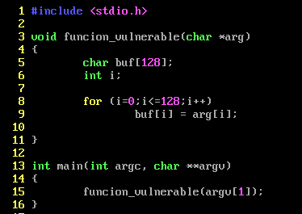

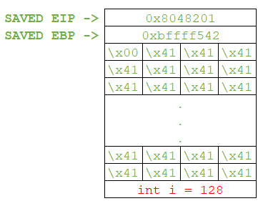
Buffer overflows — Off by one buffer overflow
The buf array length is defined as 128, it is a char array, so its size is 128 bytes in memory when reserved.
the strings are usually ended by using the null byte character \x00, this is for the program to know where the string ends. By the way, a valid string to the program should be 127 A’s, because the null byte is also copied to the buffer.
In this case (127 As), after the for loop is ended and all the bytes from the argument are copied to the buffer, the stack frame of the vulnerable function stays as intented. The program can continue using the saved EBP that was pushed when the vulnerable function was called.
for (i = 0; i <= 128; i++) is executed 129 times.
Notes:
/,stegə'nɔgrəfi/

Slide 16
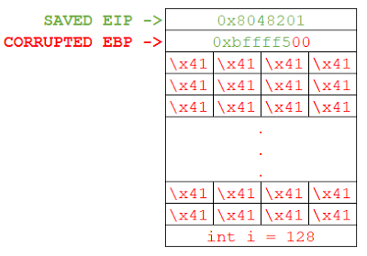
Buffer overflows — Off by one buffer overflow
The buf array length is defined as 128, it is a char array, so its size is 128 bytes in memory when reserved.
But if 128 A’s and the null byte character at the end, the total size of the string to be copied will be 129 bytes. Accordingly to the vulnerable for definition, the loop execution will run 129 times, then the for loop will try to copy 129 bytes to the reserved 128 bytes buf memory. If working with little-endian format, we will overwrite the least significant byte of the saved EBP with a null byte by entering as payload 128 A’s. This will cause that the saved EBP address will change from 0xbffff542 to 0xbffff500.
for (i = 0; i <= 128; i++) is executed 129 times.
Notes:
/,stegə'nɔgrəfi/

